Slide 1
Welcome
Notes:
Welcome! I’m excited to have you here today. We’ve got an incredible session ahead, and I’m confident that it will bring value and inspiration to each one of you. My name is Nina Booysen and it is such a joy to host you today with my co-host, Ian. Thank you, Ian

Slide 2
About Us
We guide ministries on their learning
journey towards their full potential.
Notes:
To those new to FiftyFour or these Live Learning sessions, a special welcome to you and I hope to see you around more. We are FiftyFour and our mission is to guide ministries on their learning journey towards their full potential. We love seeing leaders equipped to grow the health of their organisation so that you can apply your best energy on the work of your mission. A few practical elements before we start..

Slide 3
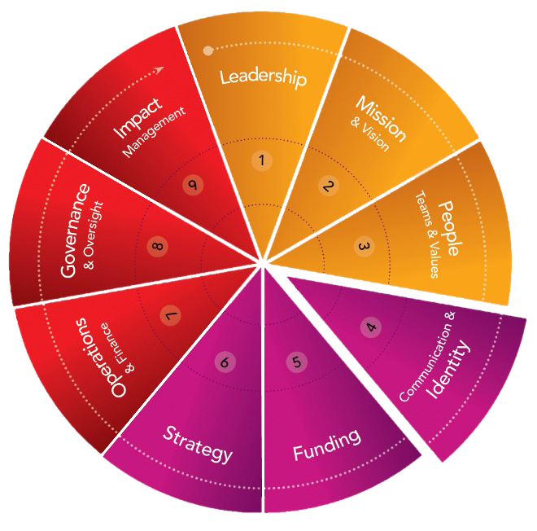
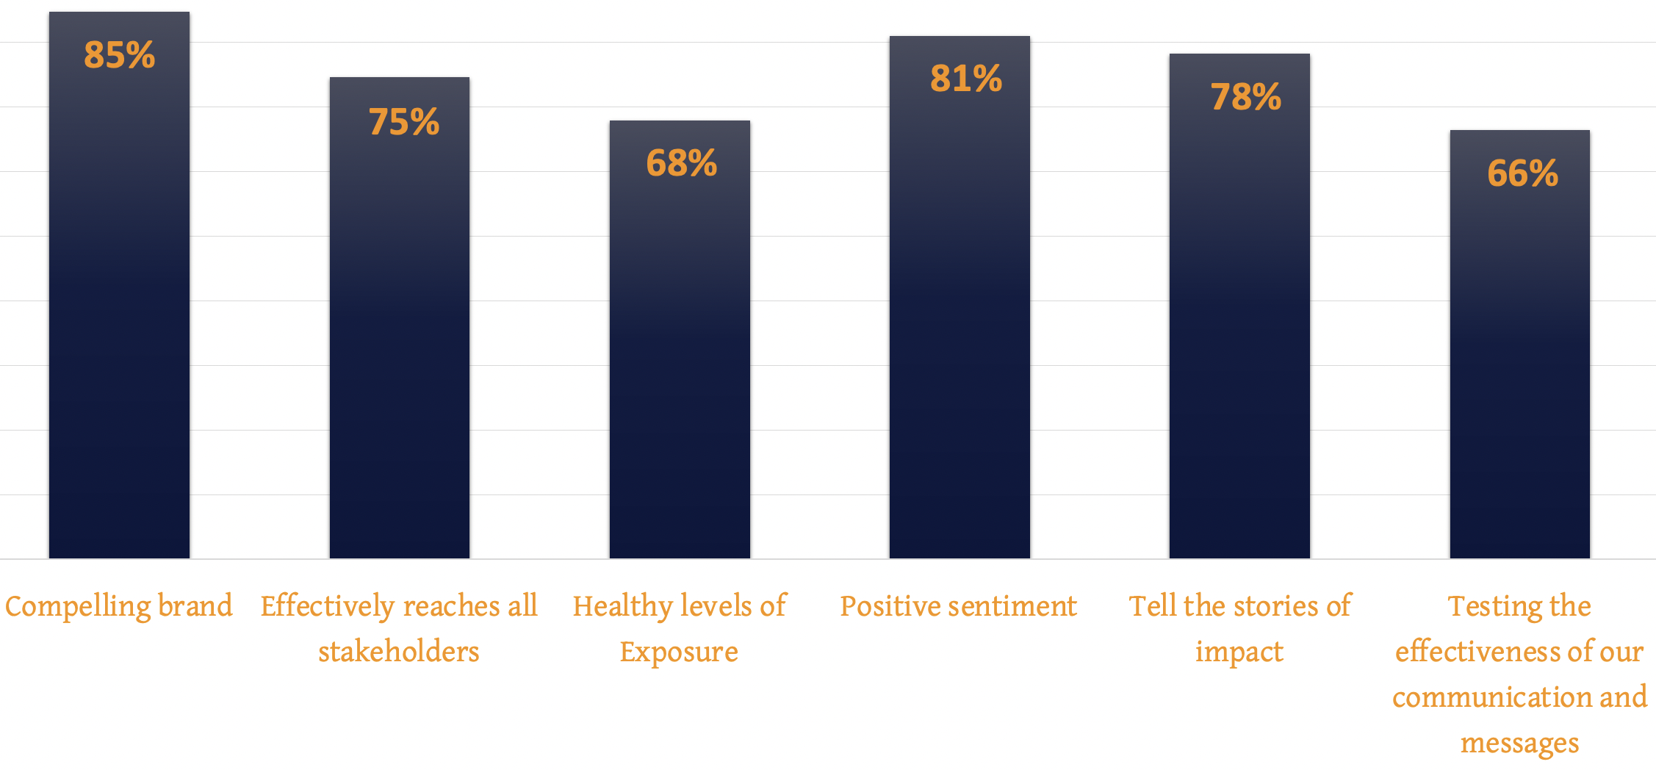
Brand Impact
Source: 9D Assessment Data, FiftyFour
Notes:
This is data from our 9D assessment where we can see that most leaders say they have a compelling brand, and that is great to hear! What we also see is that most leaders struggle with getting healthy levels of exposure and also the tools and knowledge to test the effectiveness of their communication. And this is so important because although we know who we are and what we are about, we also want to attract and connect with the right Funders and volunteers and organisations who would like to partner in our mission. So the low scoring elements in a way feels like the front door that leads others into our organisations – Ian, what are your thoughts on this?

Slide 4
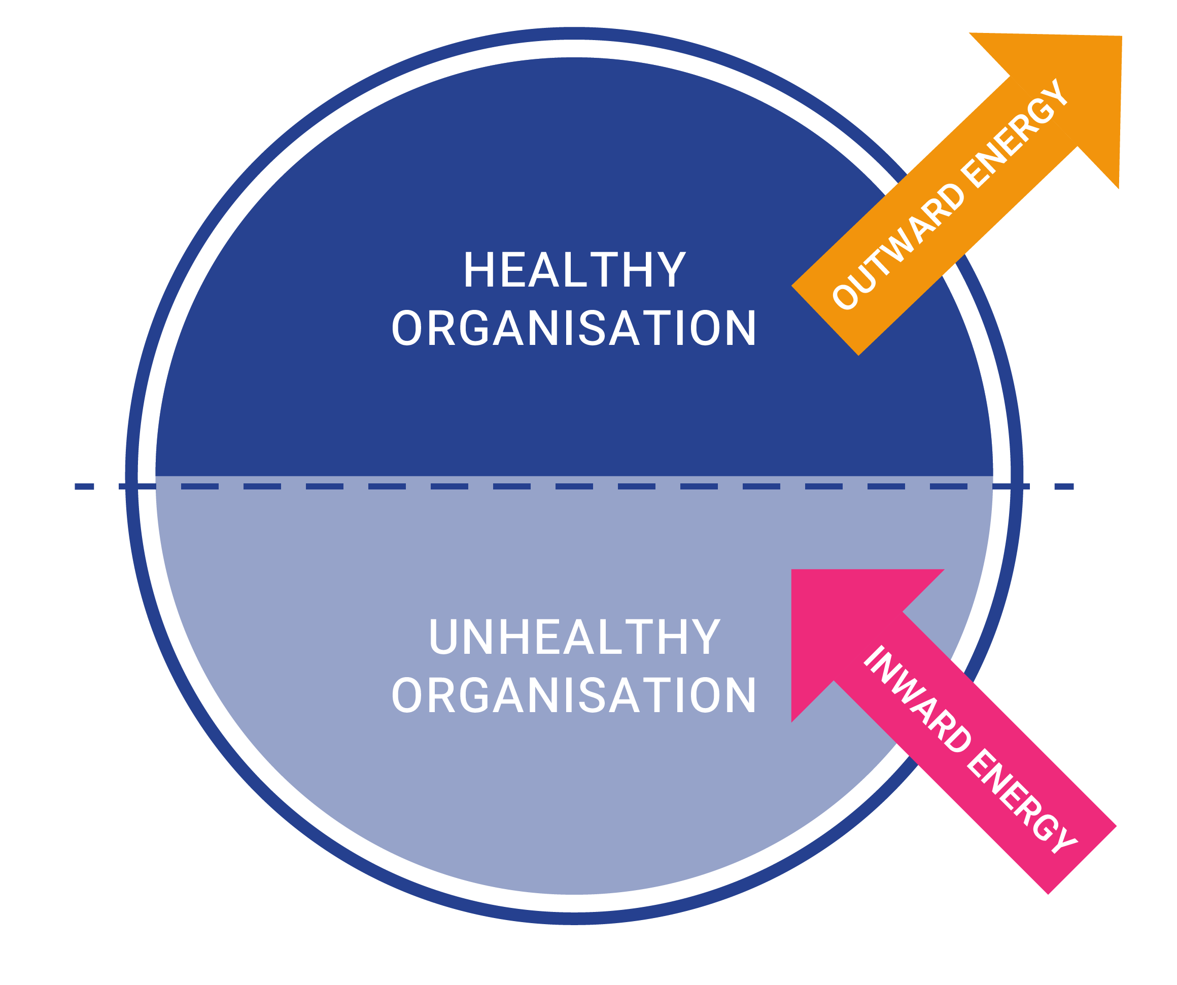
Energy Focus
When organisations are unhealthy, energy is sucked inwards, away from critical missional impact and into the organisation.

Slide 5
Korey Rich
AMPLIFY YOUR BRAND
Understand Your Audience and Grow Your Reach
Notes:
Remove the 5 graphic background and bring in logo that contains ‘Live Learning’ like the ‘Virtual Classroom’. Clean and effective.

Slide 6
A little about me…
Brand & Marketing Strategist
Reside in Virginia in the United States
Wife and mother to 2 small children
Spent the last 7 years of my career in Marketing and Branding, 4 of those were spent exclusively working for Christian nonprofits
Examples of ministries I’ve had the privilege of working with: Water Mission, The International Mission Board, Our Daily Bread Ministries, international and local Christian schools, small local ministries
Notes:
I’ve worked with ministries large and small and all of them have been able to implement some really fun and impactful marketing strategies.

Slide 7
Today’s Agenda
We Will Cover:
How to Ensure You Have a Brand Worth Elevating
Understanding Your Market
Breakout Room!
The Importance of Testing and Assessing
Quick Tips for Choosing the Right Channels
Breakout Room!
Group Discussion & Questions
Notes:
Today is all about strategies to Amplify Your Brand! My goal today is for you to leave more confident in what you’re marketing and how to market it.

Slide 8
How to Ensure You Have
a Brand Worth Elevating
Notes:
Before we get into tactical strategies for marketing your brand, we need to make sure you have a brand that will resonate with your audience.

Slide 9
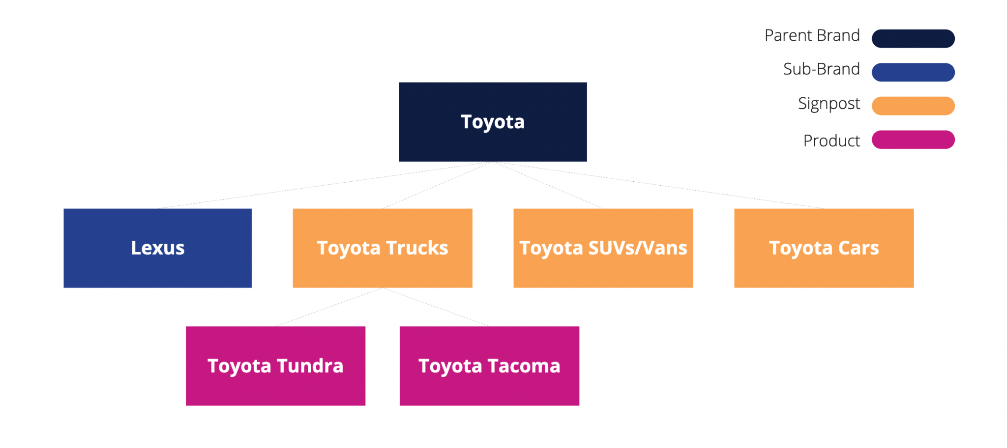
Form a Clear Brand Strategy
One of the most common mistakes I see ministry leaders make is investing
in marketing their organisation before they’ve fully aligned on their brand.
Before marketing, organisations should be aligned on:
Brand Architecture: a map of everything the organisation does and how it all fits together
Brand, sub-brands, products (and identify signposts)
House of brands, branded house, or hybrid model
Brand Strategy
Target Audience
Promise & Benefits
Personality
Notes:
You don’t want to invest time and money into marketing before you have a clear and effective brand.
Brand architecture:
I’d say this is one of the most important conversations ministry leaders need to have before investing further in marketing or even their brand identity. Especially smaller ministries need to consider what their vision for growth will be so they can continue building a clear brand in the future.
Example - if you are a ministry that distributes Bibles to parts of the world that is in need of them and you also do Bible translations, how does that work fit together? Are those 2 separate sub-brands in the ministry? Or are they more closely related as simply “products” (or services)? This will effect how you market these parts of your ministry, from displaying them on your website, to choosing visual elements to describe them, to distributing mail asking for donations.
If you aren’t sure about this, there’s a course that goes into more depth and I encourage your leadership to have a conversation about this - it’s super helpful for alignment, especially as you make plans for future growth.
Brand Strategy:
It’s so important to know your audience - who they are, what they like, what their fears and motivations are, where they spend their time, other brands that influence them. This will be instrumental in investing in the right channels to reach them. We’ll get more into how you can understand your audience in a bit, but it’s also important to know what example you are promising as an organisation. What is your unique value proposition that sets you apart from others? What about your organisation is beneficial to your audience? And then what makes you, you. Does your organisation have a sense of humor? Do you come across as a wise elder? A friend? Are you a trusted professional? All of this will influence the messages and visuals you use to market yourself.

Slide 10
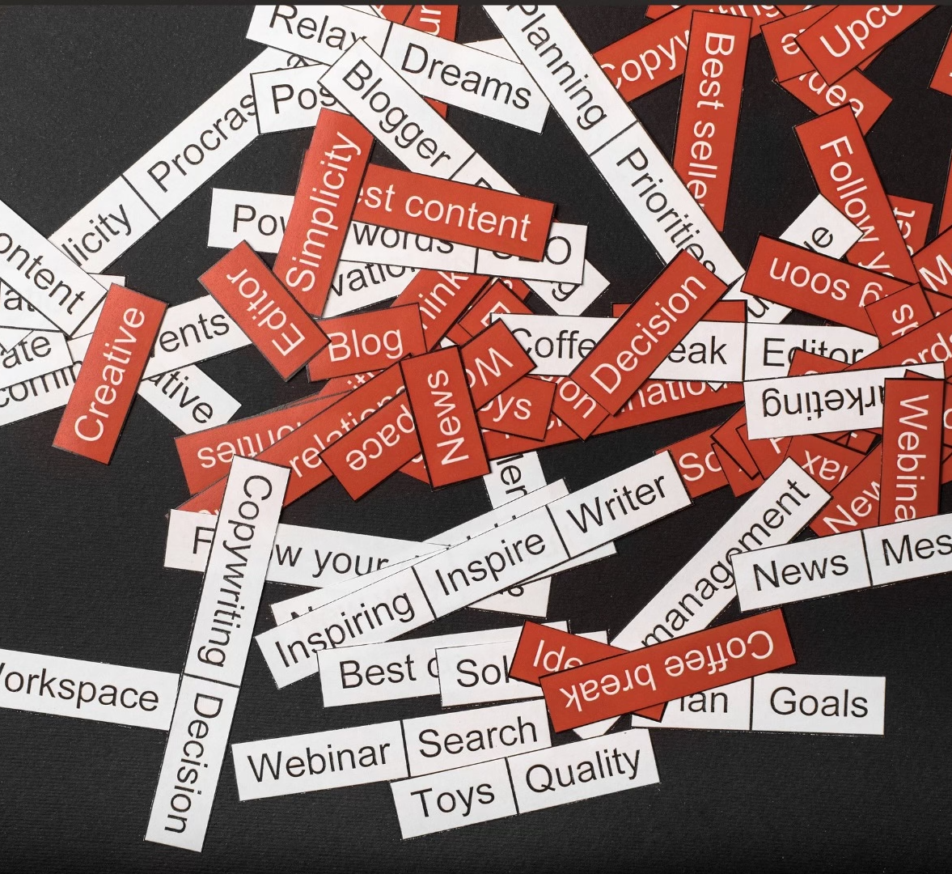
Aligning Messaging
to Brand Strategy
Name of organisation
Tagline
Voice & tone
“About us” copy
Calls to action
Notes:
Ok let’s take a little deeper look at how your brand strategy affects your communications. We’ll start with messaging, or the words you use to talk about your ministry.
Components of messaging include:
The name of your organisation
Your Tagline
Voice & tone
“About us” copy on your website, social media, print communication
And Calls to action you use to encourage your audience to engage with your ministry

Slide 11
Examples
Example 1:
Together, we can end the water crisis
Since [being] founded in 2006, we’ve been chasing one ambitious goal: ending the global water crisis. And while the water crisis is huge, we’re optimistic. We know how to solve the problem, and we make progress every day thanks to the help of local partners and generous supporters. If we work together, we believe everyone will have access to life’s most basic need within our lifetime.
Example 2:
We are a team of builders. As engineers, marketers, implementers, fundraisers, volunteers and donors, each of us is building an important piece of a solution that lasts. Each engineering plan, pipe fitting, and installation is a piece of a solution that God is using to place communities around the world back to where He intended them to be. We believe we are following His blueprint. God never intended for some to have safe water and others to suffer. So each of our actions—in partnership with yours—adds up to lives saved.
Notes:
This is the “About” copy from the websites of 2 different nonprofits. Both nonprofits are both focused on solving the water crisis.
I’m going to read them aloud and I want you to pay attention to the personality each conveys and the types of audiences you think each draws in. (READ)
-Example 1: Drop in the chat what adjectives come to mind when I read that. How would you describe the tone? (confident, inspirational)
-Example 2: Let’s do the same exercise - drop in the chat words that describe the tone you heard. (hopeful, community-focused, uplifting, Christ-focused, technical (uses language about pipes, engineering, installations)
They are saying the same thing - but they’re saying it differently.

Slide 12
Aligning Visuals
to Brand Strategy
Logos
Colours
Fonts
Boldness and structure of lines and shapes
Symbols
Photography style
Notes:
Your brand strategy also influences the visuals you use to communicate your brand. Visuals include logos, colors, fonts, line structure and shapes, symbols, photography style
On the screen here are some brands you might recognize. I’d like for you to drop in the chat some things you notice about any of these logos that you think communicates something about their brand. I’ll start by giving an example - Instagram is the logo at the top left. It’s bright and multicolored, showing it’s fun and expressive. It shows the outline of a camera indicating it has to do with photos, but also uses curved edges for the camera square, showing it’s not rigid.
Those are a few things I notice - go ahead and have some fun throwing out some things you notice about these visuals - there are no wrong answers. This is just an exercise to get you thinking.
Nike: fast paced- moving toward the future
Lego: playful, adventure (primary colors of red and yellow seem youthful)
Amazon: smiling, positive, trustworth, font choice is professionally but not dated and friendly, arrow points from a to z, showing range of products, black conveys authority
CVS: blood, health, heart for caring
Coca Cola: timelessness, classic, passion, appetite

Slide 13
2. Understand Your Market
Notes:
Ok, let’s move on from your brand’s identity to talking about how to better understand your market.

Slide 14
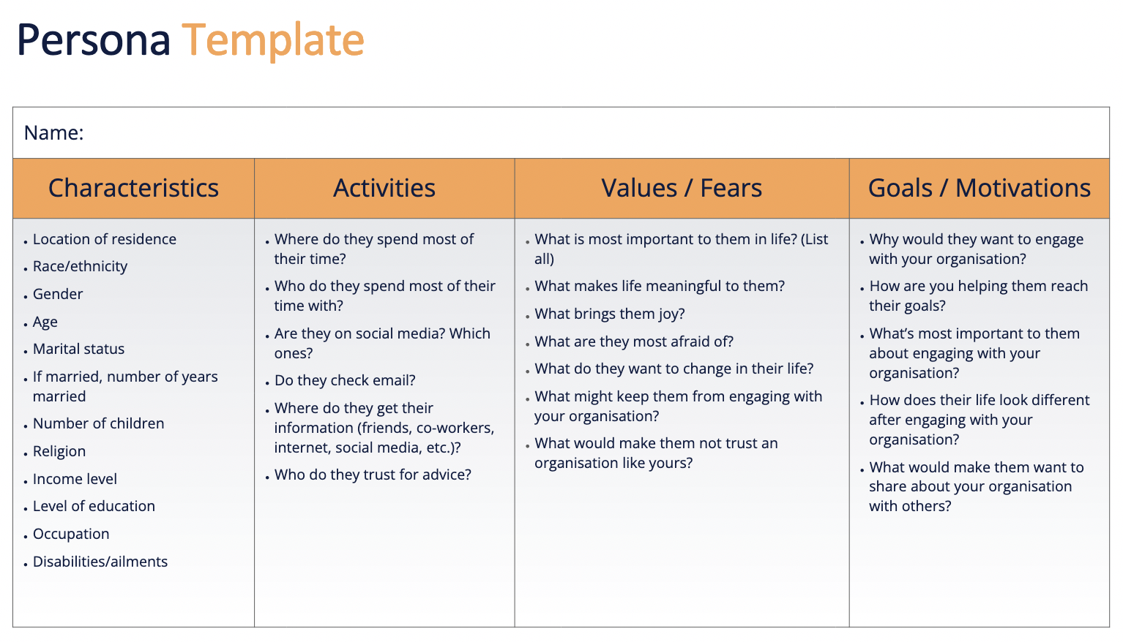
Know Your Audience
Do you have an audience persona?
You need to understand who your audience is – beyond
their demographics – before you can reach them.
Qualitative Research (interviews, focus groups)
Quantitative Research (surveys)
Pull existing data
Notes:
First, you need to know your audience
Do you have an audience persona? A persona is a fictional person with particular characteristics, activities, values, and goals that represents the average person in an organisation’s target audience - so a person you’ve created to represent your organization’s target audience. Drop a 1 in the chat if you have a persona.
Why are they so important?
Imagine that I was throwing an event that I wanted Nina to attend, but I had never met her. Let’s say I knew her age, her city, and that she is a woman. From there, I made assumptions. That would help me to an extent. I would know that due to her age, I’d likely be better off reaching her on social media than via email. But what would I have at the event that would appeal to her? What would I advertise on the invitation? With the information I had, I’d probably just go with a generic, brightly colored invitation to try to grab her attention that I throw up as an Instagram ad targeted at women in her city within her age range. Maybe that would work?
Now, imagine that I had the opportunity to speak to Nina before this event. I had asked her what her favorite music was, what kind of food she liked, where she and her friends hung out on the weekend. Maybe I even got her phone number. Well now she is going to get a very personal invitation via text message saying that the event is at one of her favorite restaurants that we rented out, limitless tacos are on us, and Taylor Swift will be performing live! Is she more likely to come? (Of course, this is made up and none of that might appeal to Nina in real life). But you get my point.
If you know your audience on a more personal level, you can better reach them.
If you have a persona, it’s great to do some ongoing research annually to continue to refine it. If you don’t have one, it’s never too late and I encourage you to use the template provided in FiftyFour’s course and create one.
The best way of getting data to fill in your persona is through qualitative data - conducting interviews or even focus groups in which you get to talk to members of your audience and ask them about why they are involved in your organization, what else they’re involved in, what their motivators are, their fears are, etc.
Quantitative survey data can also be super valuable, especially for collecting demographic data. There are a lot of great survey tools out there, some are free.
If you feel like you can’t invest in any research, it’s helpful to just pull an existing data you have - can you tell anything about demographics or just by observing your audience? Is there someone you know that you feel like represents your average audience member and can you build a persona around that person?

Slide 15
Wait!
Who is my audience??
Notes:
Wait! Some of you might be asking, who is my audience? I have board members and donors and volunteers and we also serve this population. It’s ok.
A lot of ministries get confused about who they should be targeting and creating a persona for… and that’s understandable! You often have a lot of stakeholders involved. Here’s the rule of thumb: if you are an organization that serves a population, the people you serve are your primary audience who your brand should be built around. You will also have a secondary audience of donors. Sometimes, this donor audience is so set apart from those you serve, they require their own sub-brand with unique messaging and visuals. (Example: pregnancy center - can’t put Christ-focused language on website - push them away. Donors wanted different information and a more inspiring brand with Scripture woven in).
Sometimes, those are you serve are also your donors or are so closely related that they can be communicated to in the same way (ex. Our Daily Bread).
Sometimes, your audience is only your donors - these are the only population you communicate to. And sometimes you have other stakeholders involved that need their own communication (Water Mission - donors vs. engineers). So this is where I say, it really depends on the organization, and this is where understanding your brand architecture will be so helpful. Most organizations will have more than 1 persona though. And that’s great - just know when to use each persona.

Slide 16
Know Others in Your Space
What other organisations are similar to yours? What can you learn?
¹⁸ But in fact God has placed the parts in the body, every one of them, just as he wanted them to be. ¹⁹ If they were all one part, where would the body be? ²⁰ As it is, there are many parts, but one body. - 1 Corinthians 12:18-20
Organisation audit: identify 3-5 organisations with a similar audience or doing similar work and evaluate their communications, identifying strengths and opportunities to apply to your organisation
Notes:
Ok, we talked about knowing your audience. It’s also helpful to know others in your space. Even though each organization has something unique to offer, there are often many of us doing similar work. It can be so beneficial to learn from each other.

Slide 17
Know Your Own Organisation
What are the strengths and weaknesses of your communications?
Take a deeper look at your brand and communications. Identify everything you are doing to connect with your audience. What’s working well? Where are there opportunities to improve?
Communications Audit: consider a “blind” audit for best results
Notes:
And then finally, you want to know your own organization. Sometimes taking a step back and evaluating all of your communications together can be really eye opening. You’ll notice that you say one thing in a letter and another on your website, and you have certain images on your website, but totally different styles of images on your social media - this can be confusing to your audience. You might even discover you have some channels you’re using that aren’t effective and you can redistribute those resources elsewhere.

Slide 18
3. The Importance of
Testing and Assessing

Slide 19
A/B Testing
The best way to improve your communications
3 variables to test:
Channel
Messaging
Visuals
* Note: you can run multiple A/B (or even A/B/C!) tests at one time but one variable always needs to be the control
via kumveka.org
Notes:
The best way to do this is through A/B testing, which is comparing 2 different communications and seeing which yields better results
3 variables to test
Ex: Instagram Ad, Facebook Ad, Direct Mail Ad, each with 2 different messaging options, but same visual
Sometimes it makes sense to adapt visuals to the messaging, so Option A has one set of visuals and messaging and Option B has another set of visuals and messaging. Whichever option performs better, you can assume both the visuals and messaging were working well for you.

Slide 20
A/B Testing
How to Get Started
If you have a channel you know is effective, start there and only test messaging.
If you aren’t sure which channel to use, test that! I suggest running 2 “ads” per channel. This way, you can test some messaging/visuals while you have an audience.
If you are running a campaign on your existing population, your test sample should be ~10% of that population (up to 1,000).
Know the metrics you will analyse prior to running the test, and collect any historic data you can.

Slide 21
Let’s Try It!
Situation:
You send your donors “thank you” letters quarterly. You want to see if different messaging increases the amount of giving per donor. You have 2,000 donors in your database.
Metric:
$ given per donor
Variable:
Messaging
Test Sample:
200 donors
Summary:
1,800 donors get original messaging (A) in their letter. 200 donors get new messaging (B) in their letter. We measure the average $ given per donor in group A and B and see which is higher.

Slide 22
Let’s Try It!
Situation:
You have not advertised to your audience before but would like to see if it makes a difference. You are hoping to increase the amount of volunteers at your annual event. You decide to see if an Instagram ad or mailed flyers are more effective.
Metric:
# of volunteers
Variable:
Channel
Test Sample:
100k impressions via Instagram
100k impressions via mailed flyers
Summary:
Instagram is Test A and Flyers are Test B. When volunteers register, they will be asked how they heard about the event and we can determine which channel was more effective

Slide 23
Metrics Matter
How do I know which metrics to measure?
It depends on your goals…
Increase people invested in our organisation: # of unique donors
Increase donation amount: $ given per donor
Increase number of people who know about our ministry: followers, views, impressions
Increase number of people interacting with our ministry: engagements, clicks
Effectiveness of a digital ads: Impressions and CTR (click-through-rate)
Notes:
The most important thing is to choose a metric to track and then continue to collect data on that
There is a KPI tracker in the Assessing Your Communications Course that is really helpful for getting you started - it’s a spreadsheet that will help you keep track of your metrics.
CTR (clicks divided by impressions)

Slide 24
4. Quick Tips for Choosing
the Right Channels
Notes:
There are so many channels out there, it can feel confusing to know which ones to invest your time and money in. So let’s talk about it.

Slide 25
Organic vs. Paid Communication
Every organisation should consider their owned, earned, and paid media strategy
Organic: utilising a free communication platform
Owned media: reaching out to your own network on an organic channel
Earned media: others promoting your organisation to their networks without being compensated to do so
Paid: spending money to advertise your organisation
Notes:
Owned: I posted from my LI
Earned: Nina shared my post from her LI
Paid: I paid LI to promote my post
We want to strategically leverage owned and earned media as much as possible and use paid as needed to boost our efforts.

Slide 26
Non-Digital Channels
Forms of communication that do not use the internet
Mailed letters
Printed flyers
Newspaper ads
Word of mouth
Billboards
*We often think we should rely only on digital channels to reach younger audiences, but this is not always true.

Slide 27
Digital Channels
Forms of communication that use the internet
Website
Emails
Google searches (SEO - search engine optimisation)
Social media
Spotify/radio
Television
Notes:
These channels have become increasingly popular and this is where I find a lot of organizations get overwhelmed with what they should be investing in - so let’s talk about it.

Slide 28
Who’s using which platforms?
Facebook: everyone, but esp. 30-49 year olds
YouTube: everyone, esp. 18-49 year olds
Instagram: 18-29 year olds, followed closely by 30-49 year olds
TikTok: 18-29 year olds
Snapchat: 18-29 year olds
Pinterest: 18-49 year olds
LinkedIn: 30-49 year olds
X (former Twitter): 18-29 year olds, followed by 30-49 year olds
Google: everyone

Slide 29
What is each channel used for?
Facebook: great for creating pages, groups, and events and sharing informative content or recaps (photos, videos, longer posts)
YouTube: longer videos (behind the scenes, tutorials, informational)
Instagram: real-time stories and recaps, visually interesting and engaging content (candid photos, short videos, humour, news)
TikTok: videos that feature a song, dancing, or person talking and relay insights, opinions, or make an impression on the viewer
Snapchat: fun or playful photos and videos with almost no text
Pinterest: visually appealing and shareable inspiration & ideas
LinkedIn: professional content, industry insights, and articles (may include graphics, photos, or short videos)
X (former Twitter): short, to-the-point text usually offering an insight or opinion, news (may include links or a photo)
Google: looking for information

Slide 30
So what should my ministry be doing?
Organic
Website with good organic SEO
Direct mail and email campaign to those in database
Facebook page - possibly a group page as well and events
LinkedIn page for credibility
Video posted to YouTube that is also embedded on the “About Us” page of your website
Depending on your audience, Instagram profile

Slide 31
So what should my ministry be doing?
Paid
Google Ads (paid SEO) - hire and agency if viable or have someone on your team get certified (free)
Paid mail and email campaign to purchased addresses
Consider Facebook or Instagram ads depending on your audience (large range of spend available)
*Other paid advertising truly depends on your organisation and your audience

Slide 32
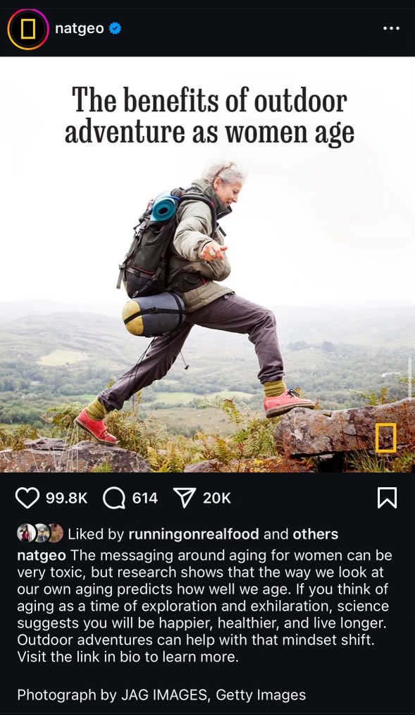
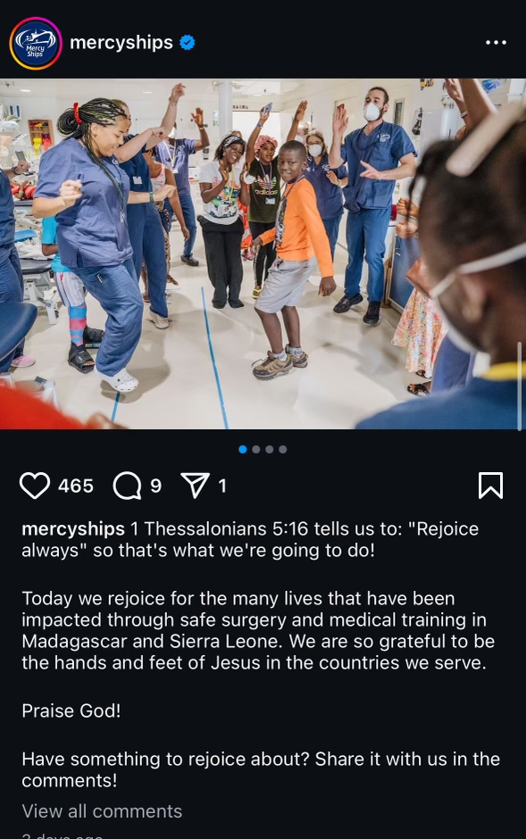
BONUS:
Quick Tips for Using Social Media Well
Generating Engagement
Captivating photos, videos, and graphics that follow your style guidelines
Include calls-to-action (CTAs) with specific asks (“comment [X]” or “visit our donate page to learn more”)
Use stories on Instagram and Facebook - have fun with them!
Use social media to increase engagement with other channels (subscribe to our newsletter, visit this webpage)
Reply to your audience’s comments, ask them to share your content, and drop a note in their DMs if they mention you

Slide 33
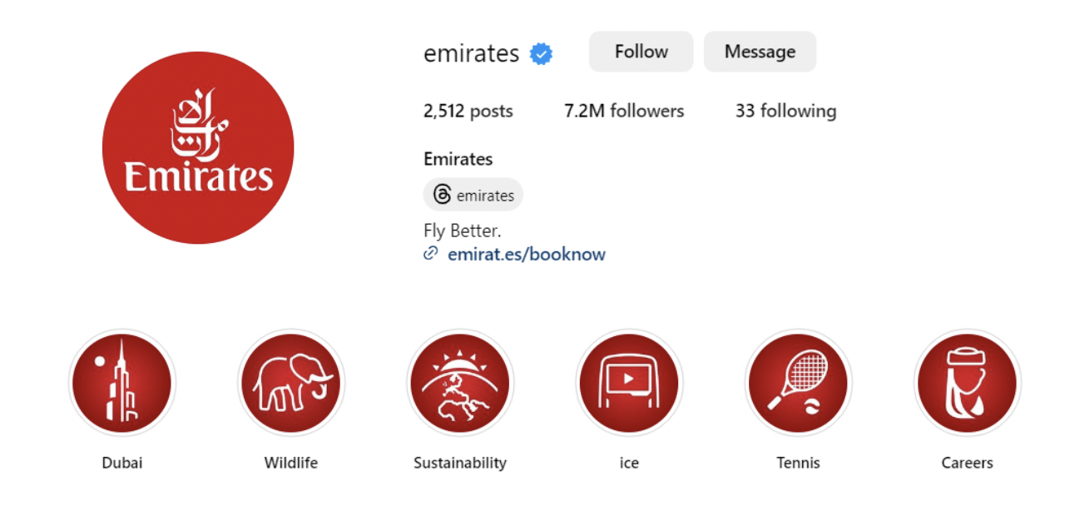
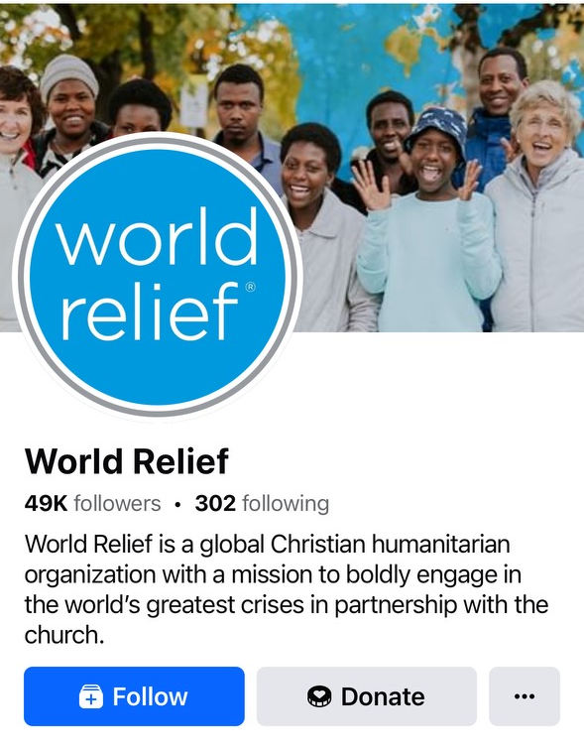
BONUS:
Quick Tips for Using Social Media Well
Optimising your profile
Cover photo: bright, vivid, high-res photo relevant to your organisation
Profile photo: logo
Bio: most important info in the first 140 characters of the Description or About section (who you serve & how)
Website: link to your homepage from all social accounts
Location: only list if you serve a specific location

Slide 34
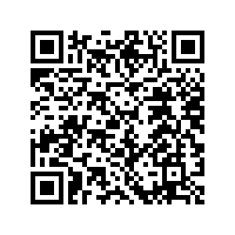
Join the Branding Workshop
WHEN:
Tuesday 22 October
16:00 (UTC+2:00)
REGISTER HERE:
Join our peer-to-peer gathering with Korey Rich where we will
host a brand workshop, diving into practical recommendations
and offering reviews on specific elements of your brand.
Scan the QR code to register.
We look forward to seeing you there!

Slide 35
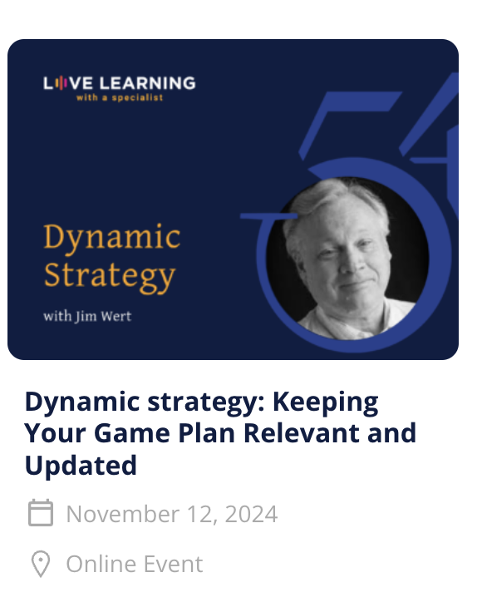
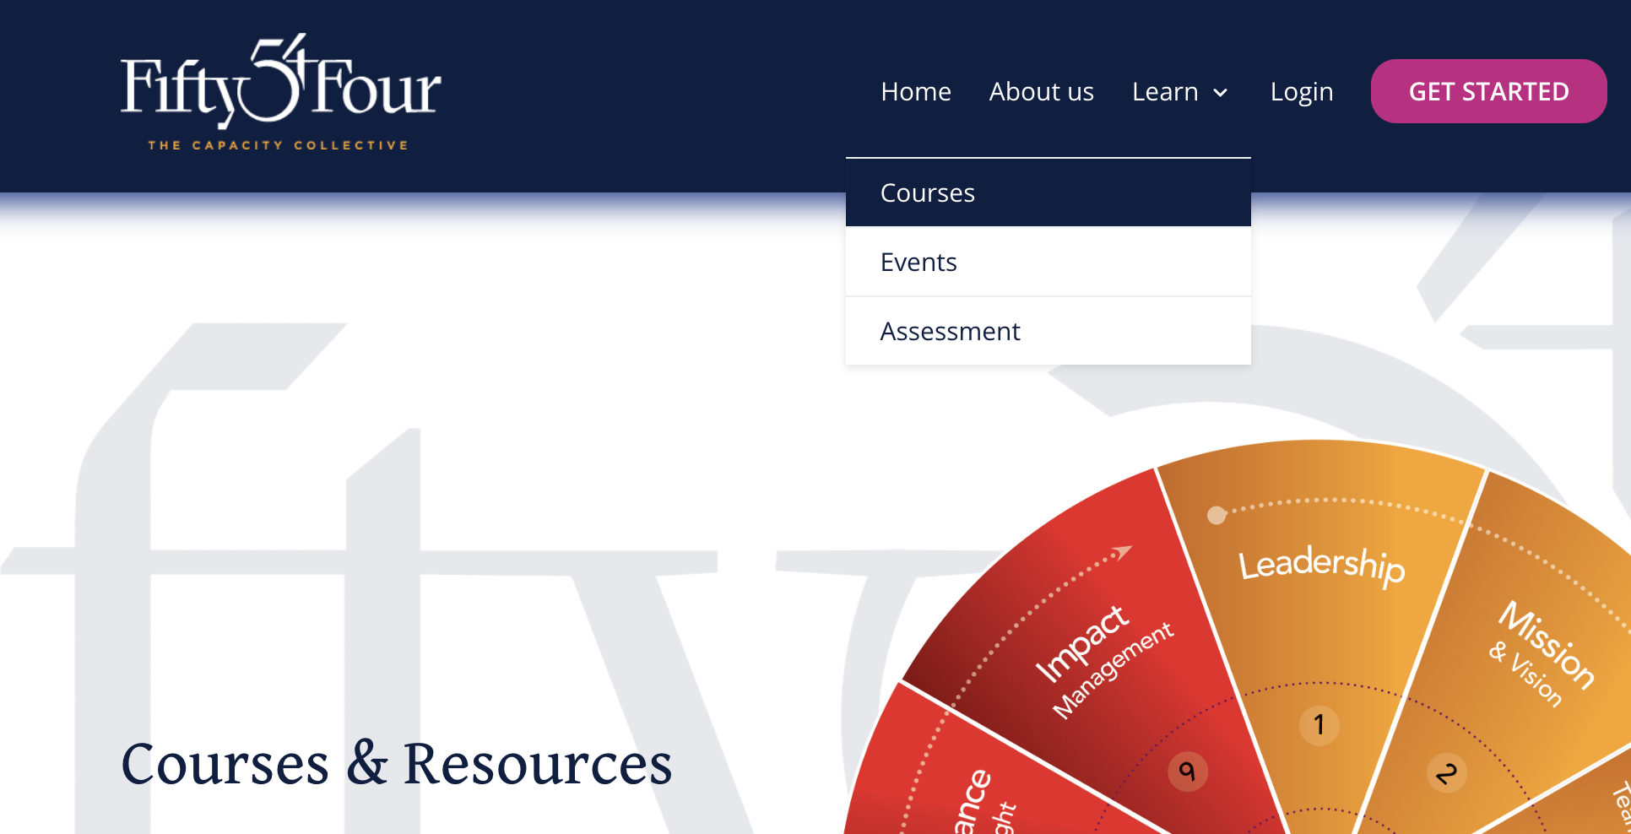
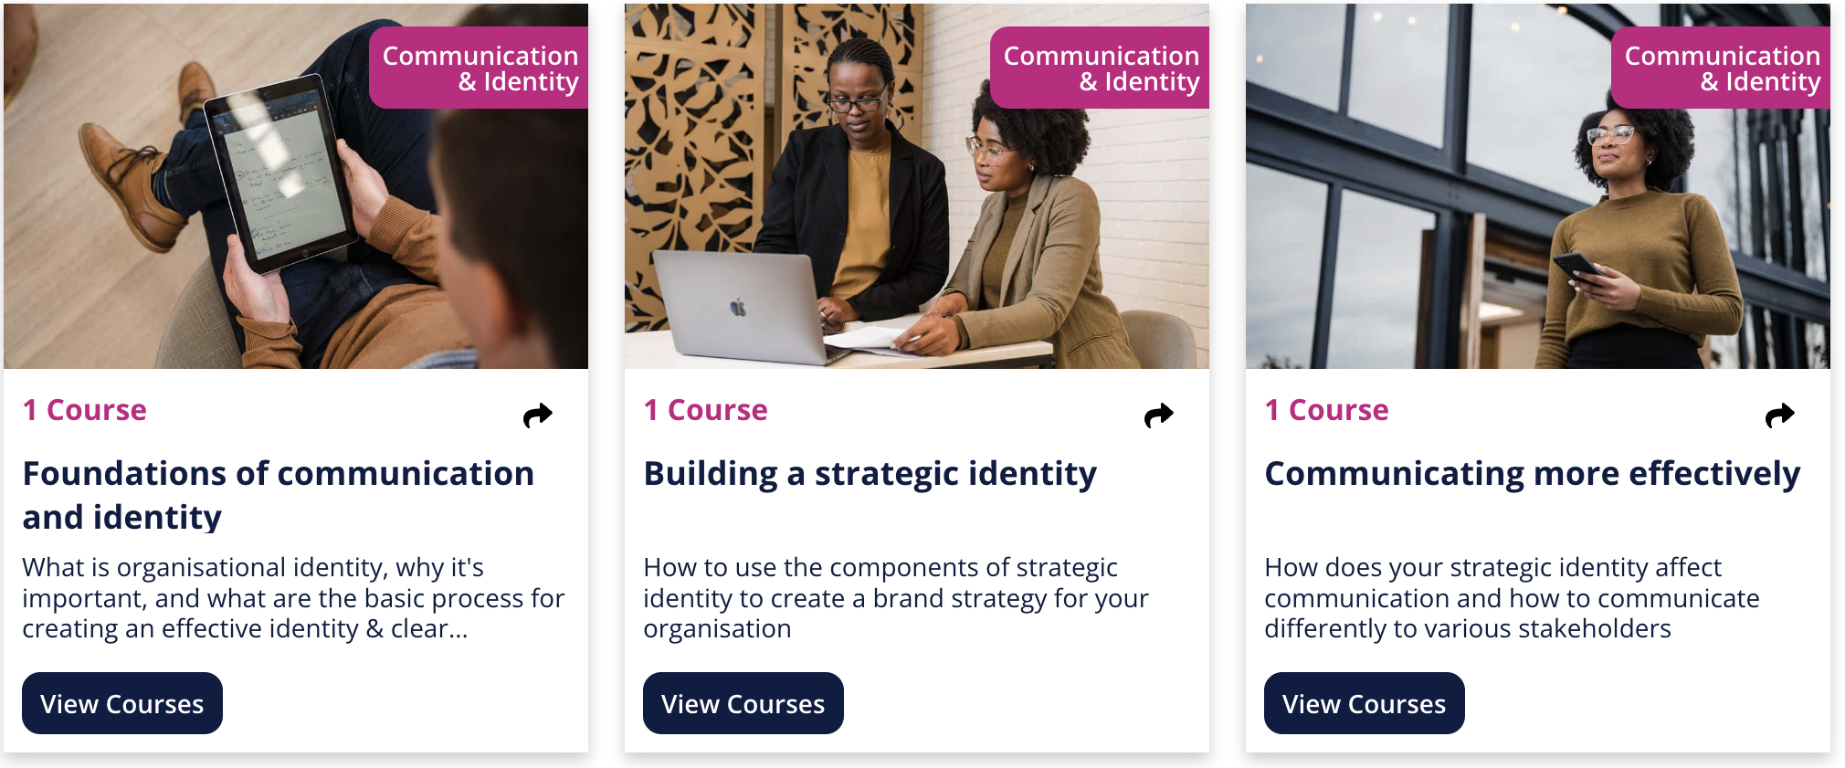
Register for upcoming events
Enrol in related courses

Slide 36
Join our WhatsApp Community
1
2
Open WhatsApp and click on the camera
Scan the QR code to join the group

Slide 37
ASSESSMENTS
COURSES & RESOURCES
LIVE
LEARNING
WHATSAPP
COMMUNITY

Slide 38
Thank You!

